Slide 1


Slide 2
What is Dependency Injection?
-Dependencies are services or objects that a class needs to perform its function. Dependency injection, or DI, is a design pattern in which a class requests dependencies from external sources rather than creating them.
Angular's DI framework provides dependencies to a class upon instantiation. You can use Angular DI to increase flexibility and modularity in your applications.
- It uses DI so that it can offer the necessary dependencies, mainly services, to the new components. The constructor parameters of a component inform Angular regarding the numerous services needed by the component, and DI provides a solution that gives the necessary dependencies to the new class instances.

Slide 3
Angular Project Look and Feel
Now let’s install bootstrap in our project to make view pretty
To install new angular external modules use npm
npm install bootstrap@4 jquery --save
This installs Bootstrap and jQuery into the
node_modules folder within the project directory

Slide 4
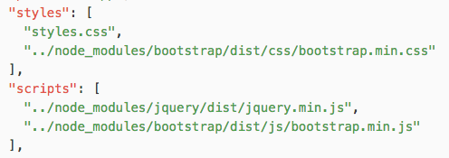
Angular Project Look and Feel
Open the .angular-cli.json file and add the css and js files of bootstrap and jQuery inside slyles and scripts arrays.

Slide 5

Angular Directives
Angular
51

Slide 6
Angular Directives
Angular
52
Attribute Directives and Structural Directives
Components Directives : These form the main class in directives. Instead of @Directive decorator we use @Component decorator to declare these directives. These directives have a view, a stylesheet and a selector property.
Attribute Directives: changes the appearance or behavior of a DOM element
Structural Directives: Change the DOM's structure, typically by adding, removing, or manipulating elements.

Slide 7
Attribute directives
Angular
53
NgClass—adds and removes a set of CSS classes.
NgStyle—adds and removes a set of HTML styles.
NgModel—adds two-way data binding to an HTML form element.

Slide 8
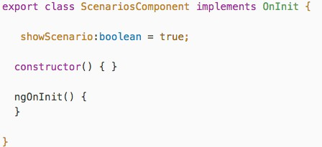

Angular Directives
Angular
53
ngIf

Slide 9

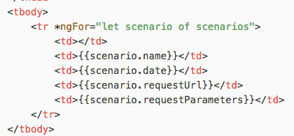
Angular Directives
Angular
54
ngFor

Slide 10
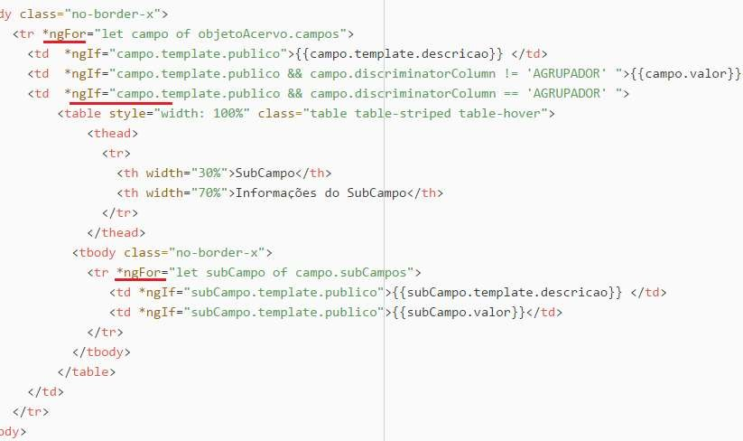
Angular Directives
Angular
55

Slide 11
That’s All For Today Day-3 !!
Questions?

Slide 12
Thank You
shiva1991@live.com

